Slide 1


Your
LEADERSHIP DEVELOPMENT PARTNER
gain?
What do you stand to
Notes:
The purpose of this call is for the next 30 minutes, to dive deep into the current challenges you are facing and how solutions and services can be tailored to a customized road map.
At the end we're going to share an assessment that we have that's really going to help identify the next steps moving forward.
How does that sound? Are you ready to get started?
Great, let's jump in!

Slide 2



HOW WE WORK WITH YOU
Identify Challenges
+
Tailor
Solutions
+
Engage
Team
=
CUSTOMIZED ROADMAP
Notes:
This is a framework that we use with our clients to show how we can support you and your team.
As I mentioned, first we will identify what challenges are you facing today and prioritize them.
Next we will share how we can tailor our solutions to your specific needs and show how have other companies utilize our services to tailor to their unique challenges and what are the results they've been able to quantify.
Now, that we've identified the needs and the potential solutions, we will provide an assessment tool so that together, we can get buy in from your team.
Finally we will gather up all this information and provide a Customized Roadmap outlining deliverables, meetings, timing, etc.
Does that make sense? Great.

Slide 3
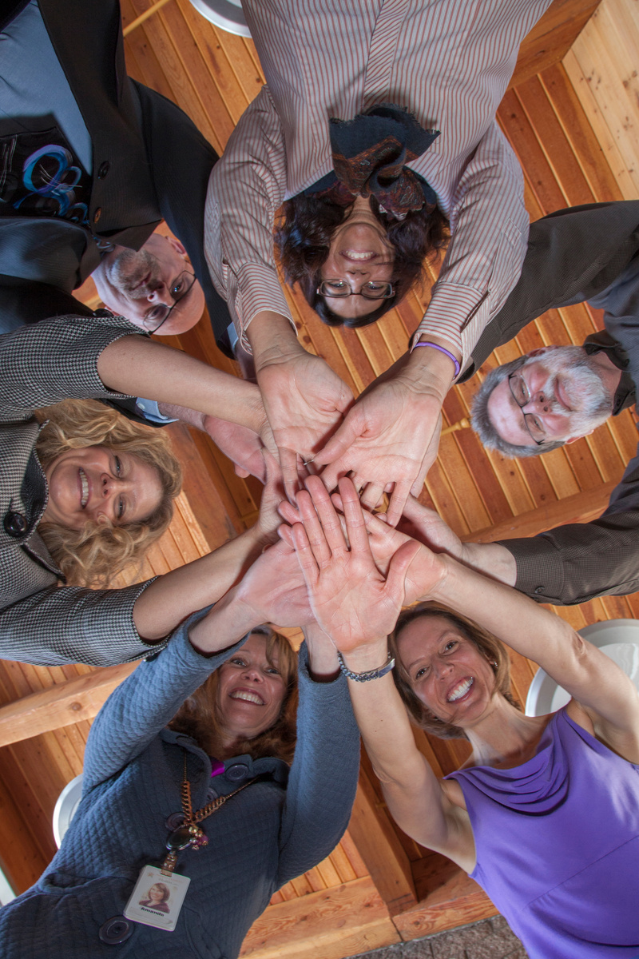

The 30,000 foot view
Identify Challenges
Employee retention
Innovation & solution orientation
Healthy workplace culture
Enhanced leadership skills
Stronger relationships
Strategic visioning/planning
Job satisfaction, mental health & wellness
Notes:
Let's get started with Challenges. Start with 30,000 foot view
(Get them to talk about their struggles)

Slide 4
“THE WHAT”
SAMPLE TOPICS FOR LEADERS (Menu= 6o skills)
Tailor
Solutions
BUILDING RESILIENCE
HEALTHY INFLUENCE & NEGOTIATION
BUILDING TRUST, RESPECT & CONSENSUS
INNOVATION & RISK-TAKING IN LEADERSHIP
BUY-IN AND ROLLING OUT CHANGE
MENTORING & DEVELOPING OTHERS
COURAGEOUS CONVERSATIONS
ON-BOARDING FOR RETENTION
CREATING VALUES-BASED TEAMS
SELF & TEAM MOTIVATION
BELONGING & BEING A WORKPLACE OF CHOICE
SERVANT LEADERSHIP & VULNERABILITY
ENHANCING YOUR EMOTIONAL INTELLIGENCE
STRATEGIC COMMUNICATION & INFO SHARING
EFFICIENCY & EFFECTIVENESS: UPPING YOUR GAME
STRESS MANAGEMENT, SELF-CARE & EMPATHY
EXPECTATIONS & ACCOUNTABILITY
SUCCESSION PLANNING & KNOWLEDGE RETENTION
Notes:
Okay, so based on some of the needs you shared
[give a couple examples from prior page],
let's talk about "WHAT" topics we can dive into, to support these challenges.
[point out a few topics that fit the needs they mentioned].
(Remind that that we're not going to finalize this today but based on some of the things you're telling me today, and after you complete the assessment we'll be able to formalize a plan)
Now that we've brainstormed some topics that could help, let's discuss how these could best be structured for your team's needs.

Slide 5

Tailor
Solutions
THE WHAT
THE HOW
YOUR PLAN
Notes:
Okay you know we talked about your challenges and topics (The What) and based on that, there are some support solutions that we think might be best for you (The How).
But really, at the end of the day it's about engaging your employees right and getting buy in.

Slide 6
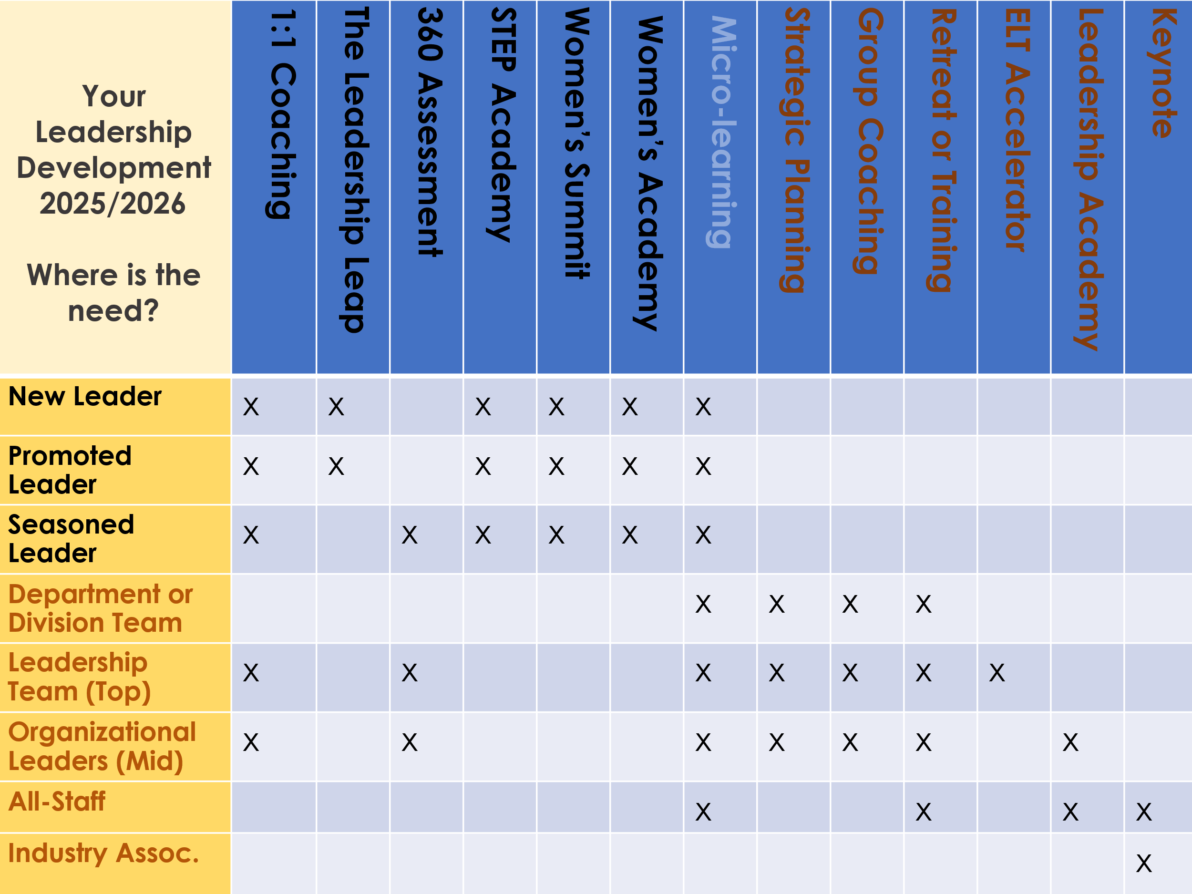
Engage
Team
“THE HOW”

Slide 7

WHO WE SERVE
Engage
Team
Orgs of 20-20,000 employees. 75,000 clients over the last 12 years. 98 organizations +.
We specialize in working with executives & leadership teams.
Notes:
We have this huge track record with such diverse companies and at the end of the we took their diverse needs.....
Mission/vision/values alignment
Operating with strategy
Change efforts
Retention efforts
On-boarding
Mentoring & coaching
Succession planning
Feedback-seeking culture
Skill development
Performance evaluation
Culture & community focused practices
Individual leadership & contribution
name some of these things, reinforce ones that they've said they may need support with
......
and unitized our assessment tool to ensure full organization buy in.
So, the next step...

Slide 8
Review the following slides if you would like even
more information
We’d be happy to assess your needs with you:
office@lancasterleadership.com or 928-607-2041
www.LancasterLeadership.com

Slide 9


OUR WORK SUPPORTS HEALTHY ORGANIZATIONS
(The 3 Desires of the Modern Employee, 2021, Jack Altman, People Strategy)
COMMUNITY
workplace culture
PURPOSE
strategy & impact
GROWTH
skill & capacity development
Replacing top performers cost 6-9 months of that salary
(Society for Human Resources Management)

Slide 10
12 MONTH Sample Strategy:
“What’s possible” Customizable Roadmap
1. Retreat
A kick-off retreat
for all staff or the leadership team (2-4 mo from now)
Pre 1. Assessment
2. Identify
Briefing of needs
Identify high-potential leaders & individuals for 1:1 coaching.
3. Plan
Leadership Skill or Thriving Culture Plan:
Leadership Academy, Quarterly Trainings
Group Coaching (select 1 or 2)
4. Strategize
Strategic Plan Creation
(if needed)
Notes:
So, after the assessment in this example ,the next step would be
1.a retreat
2.identify
3. plan .....
But the assessment is really the foundation to map out your roadmap. What questions do you have?

Slide 11
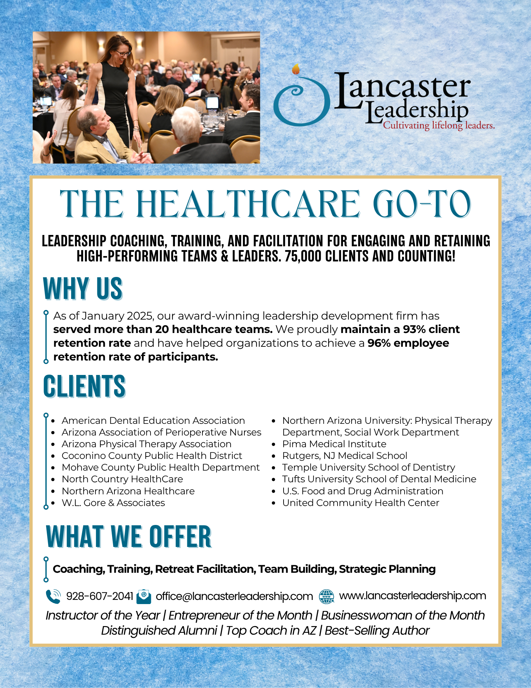
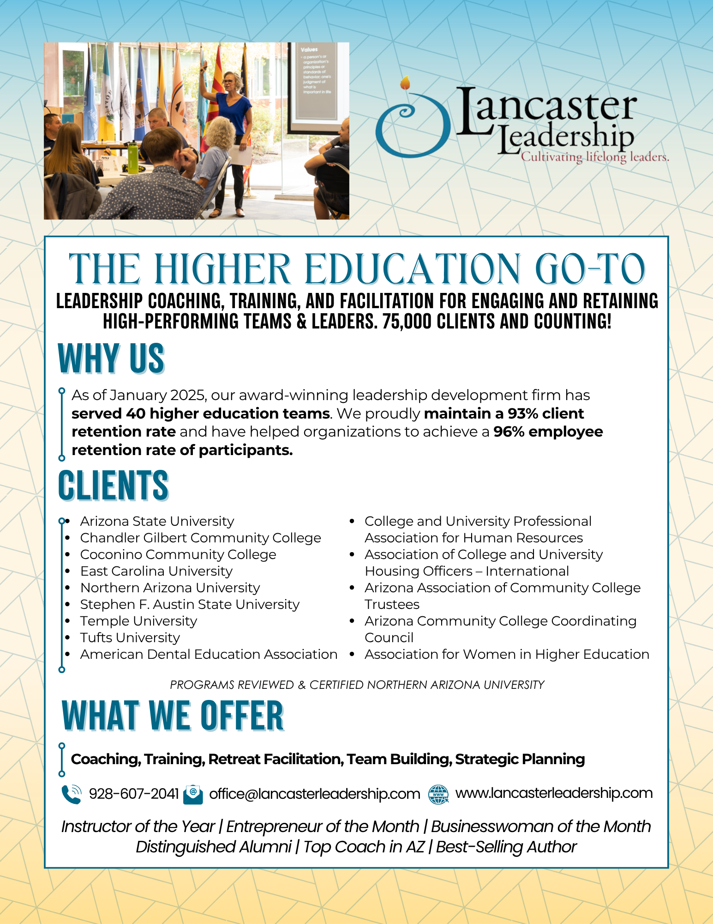
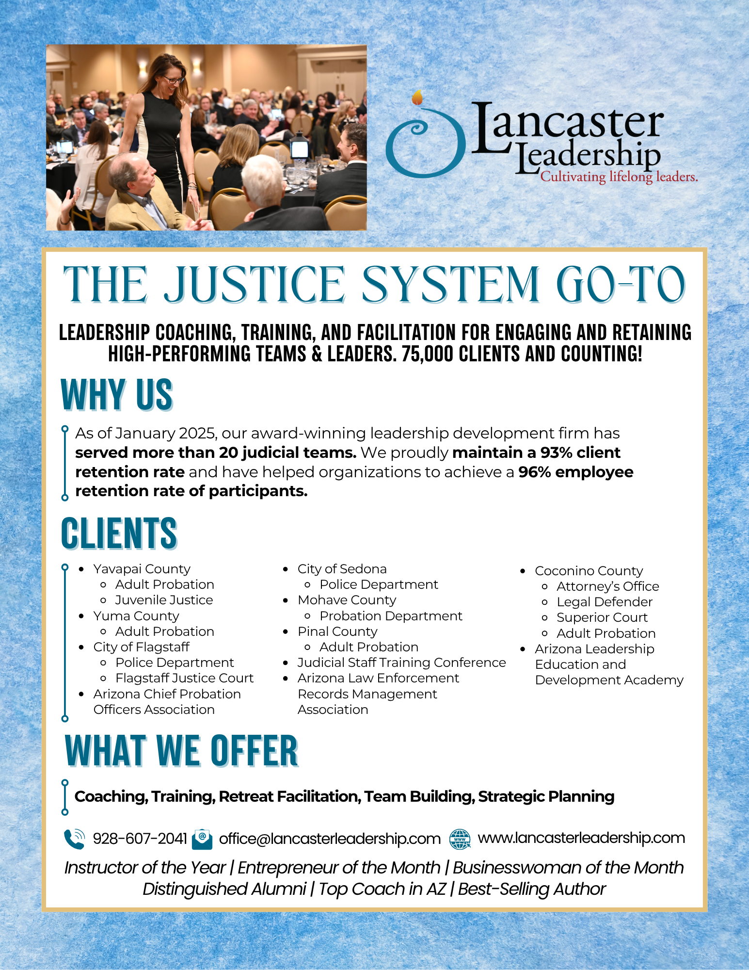
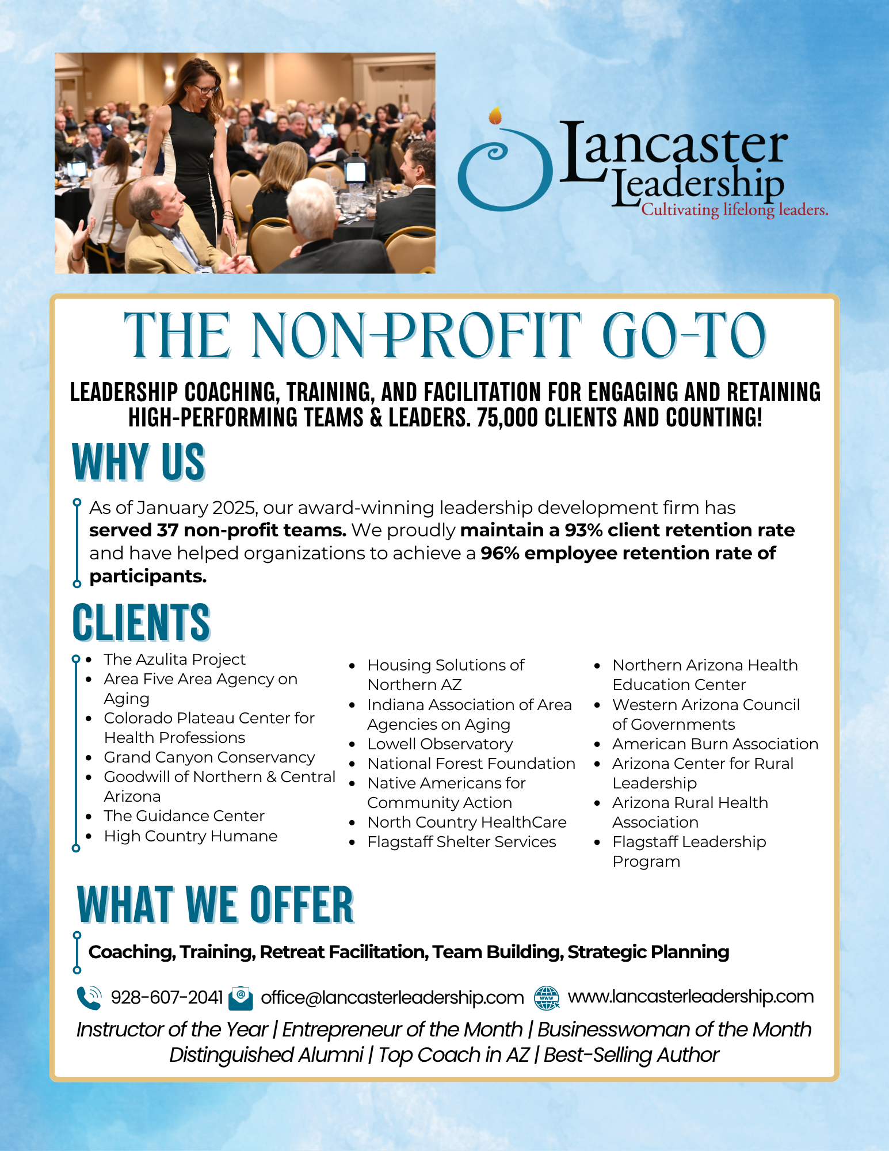
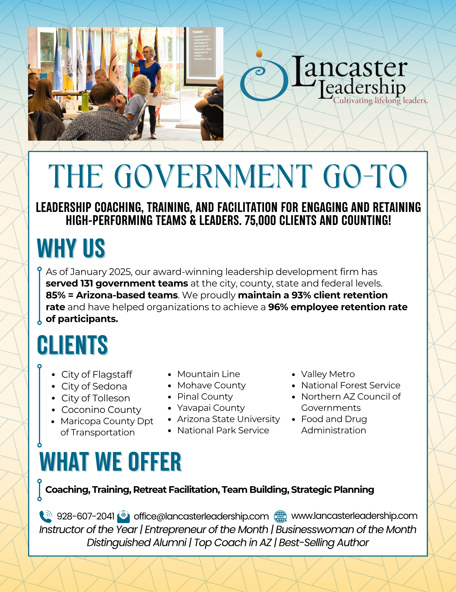
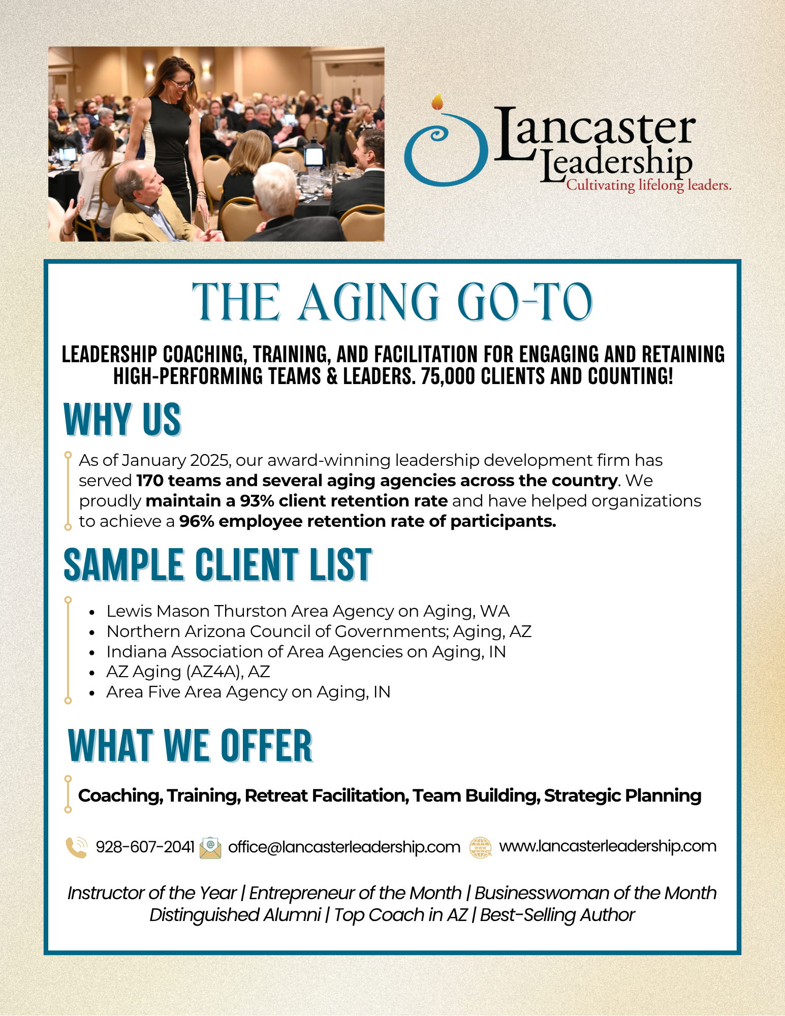

Slide 12
6 CLIENTS, SERVICES BREAKDOWN
Tailor
Solutions
Group Coaching for Teams
Group
Coaching for Individuals
Strategic Planning/ Facilitation
Trainings & Retreats
1:1 Coaching
Leadership Academy
Other
ASPEY, WATKINS & DIESEL
60%
32%
x
2%
x
3%
3%
CITY OF FLAGSTAFF
70%
9%
4%
6%
7%
2%
1%
LEWIS MASON THURSTON
Area Agency on Aging
20%
3%
10%
6%
44%
3%
14%
NACOG
(Northern Arizona Council of Governments)
16%
2%
54%
3%
23%
2%
x
NORTHERN ARIZONA UNIVERSITY
Advancement/Foundation
31%
x
x
66%
x
3%
x
NORTH COUNTRY HEALTHCARE
31%
14%
28%
16%
9%
1%
1%
Notes:
So, I wanted demonstrate how we've taken some of the challenges and topics and layered in the Lancaster Leadership Solutions/Services for some companies here in Northern AZ.
As you can see, not one of them needed the exact same support in fact they were very diverse in how we structured their unique roadmaps.
[point out a specific business and service that you want to share a testimonial on for the next slide]

Slide 13
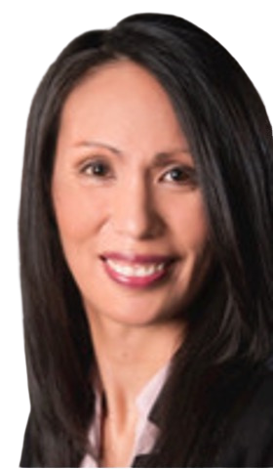
LEADERSHIP ACADEMY
Case Study Results
Over 1/3 of academy participants have been promoted.
Over 50% of academy participants applied for promotions.
Over 60% of those that applied for promotion were successful in doing so.
Within the organization, 96% of the academy participants have been retained (3 years later).
Nicole Kiddoo,
Executive Director
Lewis Mason Thurston Area Agency on Aging

Slide 14
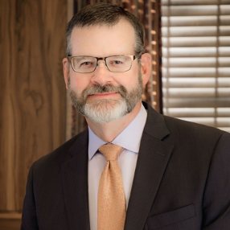
STRATEGIC PLANNING
Aspey, Watkins & Diesel
Case Study Results:
We identified our priorities and have a 3 year succession plan and a flexible professional growth roadmap for staff and attorneys.
We see what's working and what’s not, and we created strategy for the gap.
We attract and retain attorneys and staff who align with our mission with A mentorship program for associates
Growth in the size of the firm, including new roles and more diversity
New opportunities to maximize our staff expertise for our clients (that increases our profitability).
Innovative products that help us reach more of our community.
Clear expectations and SOPs that support our efficiency.
Whitney Cunningham
Managing Partner
“Lancaster Leadership came to our rescue.”

Slide 15

STRATEGIC PLANNING & RETREATS
LEADERSHIP COACHING & CONFLICT RESOLUTION
LARGE-SCALE TRAINING WORKSHOPS
Case Study Results:
Marica Martinic,
Education Director
The Colorado Plateau Center for Health Professions (CPCHP) at North Country HealthCare
High rates of satisfaction from participants
Reduced turnover in CPCHP team
Elevated employee engagement
Clarity of focus
Improved team cohesion

Slide 16
 | 1:1 Coaching | The Leadership Leap | 360 Assessment | STEP Academy | Women’s Summit | Women’s Academy | Micro-learning | Strategic Planning | Group Coaching | Retreat or Training | ELT Accelerator | Leadership Academy | Keynote
New Leader
Promoted Leader
Seasoned Leader
Department or Division Team
Leadership Team
Organizational Leaders
All-Staff
Industry Assoc.
Make
Your Selections Here

